Slide 1
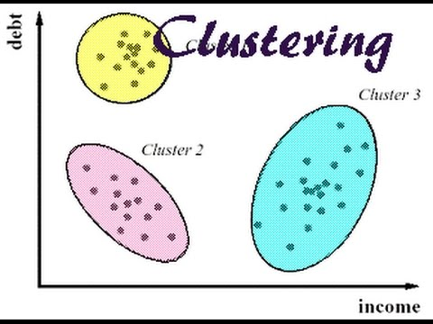
Clustering :
It is a data mining technique used to place the data elements into their related groups.
Clustering is the process of partitioning the data (or objects) into the same class.

Slide 2
Applications of Clustering
Marketing:
Clustering helps to find group of customers with similar behavior from a given data set customer record.
Biology:
Classification of plants and animal according to their features.
Library:
Clustering is very useful in book ordering.
Many Other Areas:

Slide 3
Types of clustering
Clustering methods can be classified into the following categories
1. Partitioning:
In this approach, several partitions are created and then evaluated based on given criteria.
2. Hierarchical method:
In this method, the set of data objects are decomposed (multilevel) hierarchically by using certain criteria.
3. Density-based method:
This method is based on density (density reachability and density connectivity).
4. Grid-based methods:
This approach is based on multi-resolution grid data structure.

Slide 4
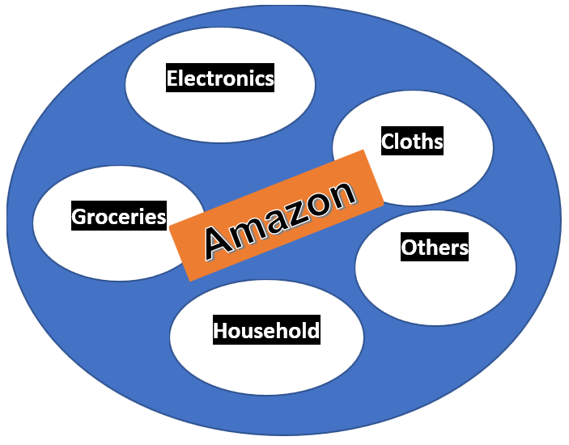
Partitioning Clustering :
This clustering method classifies the information into multiple groups based on the similarity of the data

Slide 5
Electronics Devices
Laptops
T.V.
Mobiles
etc.
SAMSUNG
APPLE
REDMI
OPPO
etc.
‘N’ SERIES
‘S’ SERIES
‘A’ SERIES
etc.
Hierarchical Clustering
A hierarchical clustering is a set of nested clusters that are organized as a tree.

Slide 6
K-MEAN ALGORITHM
{2, 4, 10, 12, 3, 20, 30, 11, 25}
Step 1: Randomly assign the means: m₁ = 3, m₂ = 4
Step 2: Group the numbers close to mean m₁ = 3 are grouped into cluster k₁ and m₂ = 4 are grouped into cluster k₂
(Step no.2 is repeated until we can not get same mean value )
Step 3: k₁ = {2, 3}, k₂ = {4, 10, 12, 20, 30, 11, 25},
m₁= 2.5, m₂ = 16
Step 4: k₂ = {2, 3, 4}, k₂ = {10, 12, 20, 30, 11, 25},
m₁= 3 m₂ = 18
Step 5: k₁ = {2, 3, 4, 10}, k₂= {12, 20, 30, 11, 25},
m₁= 4.75, m₂ = 19.6

Slide 7
K-MEAN ALGORITHM
Step 6: k₁ = {2, 3, 4, 10, 11, 12}, k₂ = {20, 30, 25},
m₁ = 7, m₂ = 25
Step 7: k₁ = {2, 3, 4, 10, 11, 12}, k₂ = {20, 30, 25},
m₁ = 7, m₂ = 25
Step 8: Stop. The clusters in step 6 and 7 are same.
Final answer: k₁ = {2, 3, 4, 10, 11, 12} and k₂ = {20, 30, 25}

